Slide 1
The Zero-plus [0+] Sensor with Actionable Signal
Resilient Grids, LLC
October, 2017

Slide 2
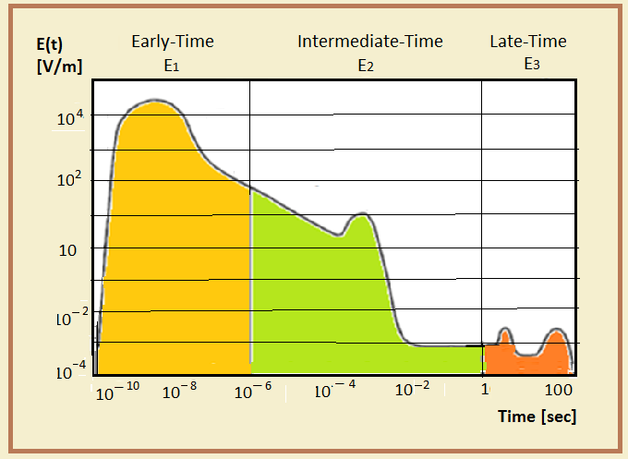
Nature of Electronic Magnetic Pulse (EMP)

Slide 3
Addressing Present Utility Industry Technical Shortcomings
Critical question for mitigation devices is the one associated to both the GIC detection and switching of mitigation devices
GIC of a quasi-DC nature poses a major current-interruption challenge as required following their detection

Slide 4
Functionality of
Zero-Plus Sensor
Allows instantaneous detection of an Electromagnetic Pulse (EMP)
Produces an actionable signal as an input to a secondary system or tripping circuit for an alert or protection purposes

Slide 5
Analytical Work and Design of
Zero-Plus Sensor

Slide 6
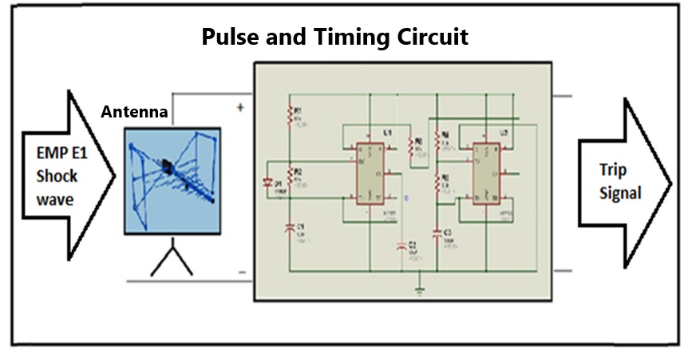
The circuit consists of a pulse and timing circuit embodied into a two-port transfer function having as input an antenna EMP pulse, and as an output an signal capable of been actionable to any control or information systems for early EMP mitigation purposes.

Slide 7
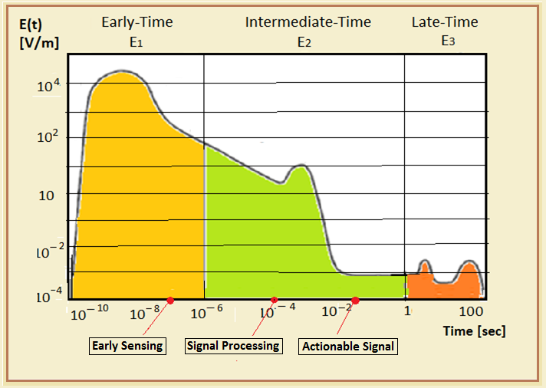
Timeline of Sensor with Actionable Signal

Slide 8
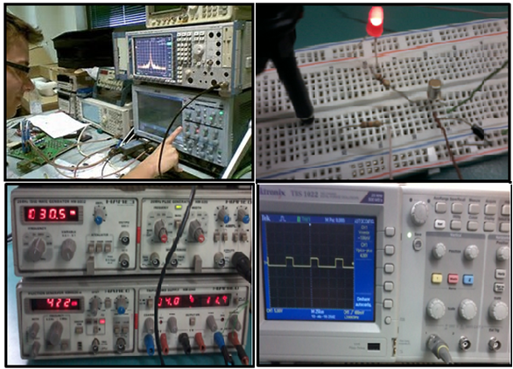
Testing of Sensor with
Actionable Signal

Slide 9
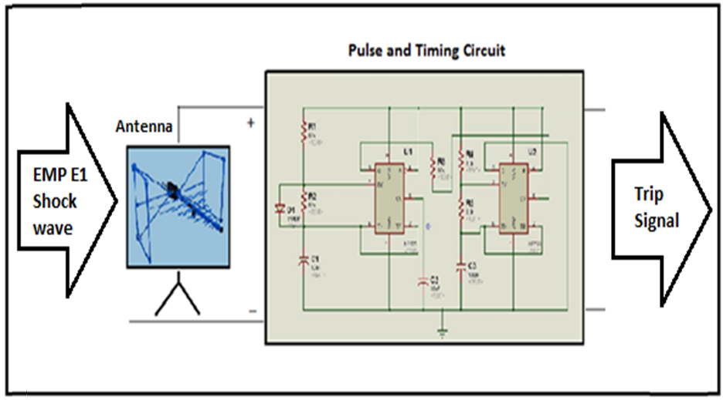
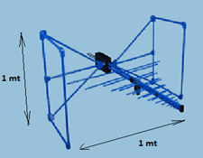
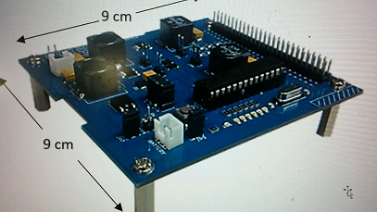
Prototype Sensor with Actionable Signal (*)
* The Zero-Plus prototype is currently under development

