Slide 1
Neutral blocking of Transformer GMD/GIC: why a Surge Arrester
Alberto Ramirez Orquin Vanessa Ramirez
Resilient Grids, LLC
Audio Presentation

Slide 2
General
Introducing a simple, cost-effective means to deal with this major hazard by means of an innovative surge-arrester GIC-blocking principle
Essential discussion regarding the impact upon transformer grounding of devices based on neutral GIC blocking

Slide 3
General
Key application to a typical Autotransformer
Significant invariance of the grounding ratios after a proposed arrester device deployment
Important revealed features set plausible benchmarking with alternative capacitive blocking devices

Slide 4
The Surge Arrester Protective Functionality
In addition to transformer and line protection surge arresters/(MOV) have been extensively utilized for series- capacitor protection
Transformer neutral-blocking devices use surge arresters for overvoltage protection

Slide 5
The Surge-Arrester Protective Functionality: its application to neutral-blocking devices
.
Exhaustive testing series performed at major high-power Labs
Full-scale testing series performed at major high-voltage Labs
Comprehensive simulations at both academic and industrial levels

Slide 6
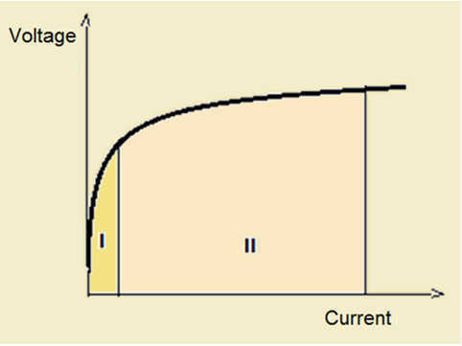
The Surge Arrester Dual Functionality
Ohm’s Law applies to non-linear resistors; mind
slopes at graph points of both Regions I and II

Slide 7
The Surge Arrester Dual Functionality
Region I: Resistance very high; consistent with GMD voltages
Region II: Resistance very low; consistent with ground-fault disturbances

Slide 8
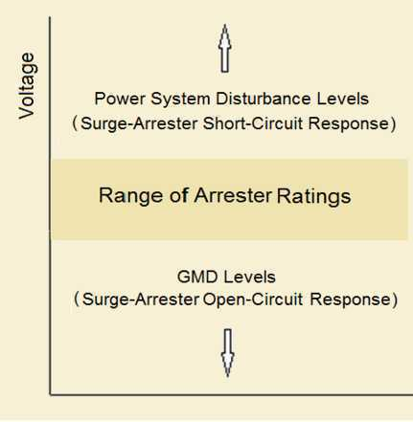
Comparative of Transformer Neutral Voltage Ranges

Slide 9
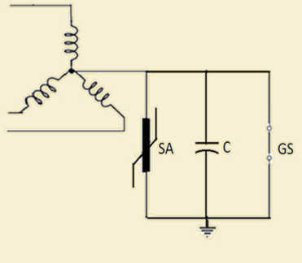
Why a Neutral-Blocking Capacitor?

Slide 10
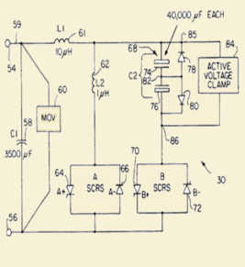
Why a Neutral-Blocking Capacitor?
Industry reluctance to this approach is due to costs, size, complexity and perceived operational risks *
Understanding this problem, and its solution, starts with consideration of three power-system design states
* Failure modes for the most part unknown

Slide 11
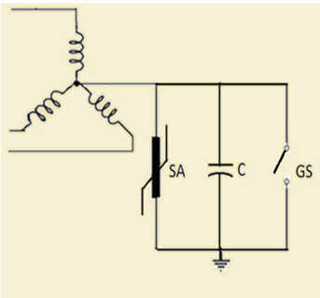
Neutral-Blocking Capacitor Facts
Neutral surge arrester protects the shunt capacitor bank from ground faults
Surge arrester also protects all components connected neutral-to-ground, including the winding neutral insulation to ground (typically 110 KV BIL)

Slide 12
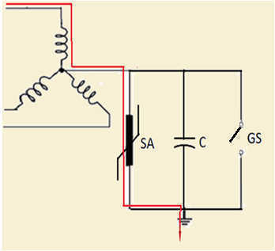
Neutral-Blocking Capacitor Facts
At ground faults surge arrester instantaneously by-passes the capacitor bank thus protecting the transformer wye winding by solidly grounding its neutral
Any perceived neutral-grounding capacitor function hence rendered unnecessary

Slide 13
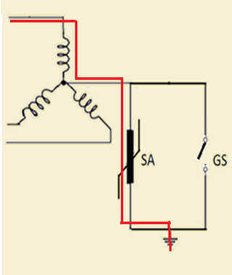
Neutral-Blocking Capacitor Facts
Through a ground fault, surge arrester does fully protect transformer winding neutral-end, besides solidly grounding it after a few milliseconds from fault inception; with or without a shunt capacitor
Significant electric utility practice on grid transformer ungrounded wye design, with neutral surge arrester applications, feasible even in that substantially more demanding steady-state operation

Slide 14
Basic Power-system device design states
Three basic power-system device design states to consider, possibly in combination:
a) Ground-Fault Disturbances
b) GMD/GIC
c) Steady State

Slide 15
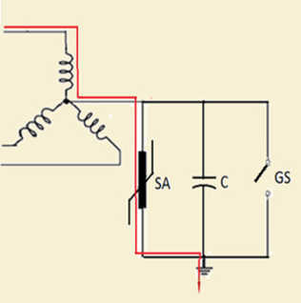
Simultaneous Condition
Ground Fault and GMD/GIC
Mitigation Device Deployed
Inconsequential; transformer protected by Surge Arrester

Slide 16
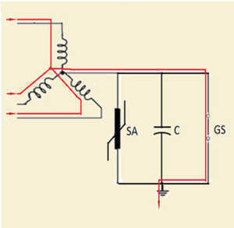
GIC-State Condition
Steady State and GMD/GIC
Mitigation Device Not Deployed
Problematic; transformer traversed by GIC currents

Slide 17
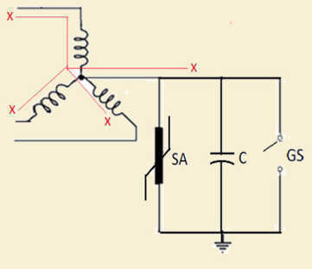
Why a Neutral-Blocking Capacitor
GMD/GIC Disturbance
Mitigation Device Deployed
Inconsequential; transformer protected by a neutral-blocking scheme

Slide 18
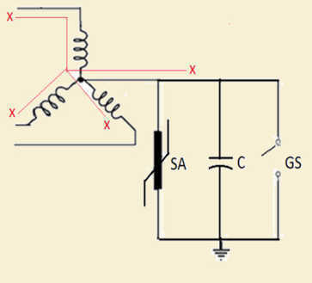
Why a GIC Neutral-Blocking Surge Arrester
GMD/GIC Disturbance
Surge arrester, in parallel with capacitor, performs a not duly appreciated blocking function identical to the one carried out
by the capacitor
Otherwise GIC current could flow
to ground through surge-arrester
path
Actually, there is a record of that problem happening in a well-documented case

Slide 19
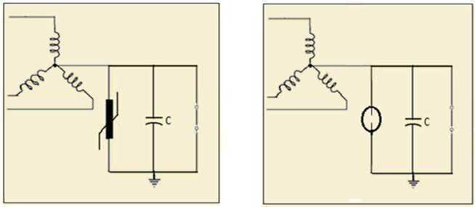
Capacitor Scheme Alternatives
Capacitor Neutral-Blocking Device
Alternative Capacitor Device

Slide 20
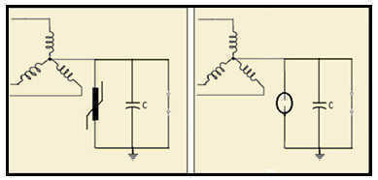
Critical Considerations
Capacitor-bank footprint/rating, a limiting factor
Capacitor-bank constrained to Distribution lower-voltage ratings
Protective devices consequently constrained to Distribution lower-voltage ratings

Slide 21
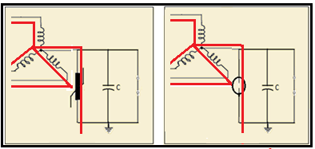
Critical Considerations
As protective devices are constrained to Distribution lower-voltage ratings a sizable EMP impact will set a neutral voltage causing either a surge arrester bypass to ground or alternatively conduction of the spark gap
GIC will then flow through the transformer to ground

Slide 22
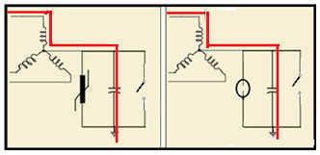
Higher blocking-device ratings and attendant protecting devices (say up to 20 KV) could be attempted, despite its exponential cost/size impact, to prevent EMP shocks from circumventing the unit However, ground faults causing lower than said 20 KV neutral voltages would directly impact both device capacitor and resonance-damping resistors setting extreme power-rating requirements for a critical time until protective switching happens
The Capacitor Neutral-Blocking Device Dilemma

Slide 23
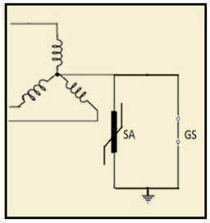
Critical Considerations
The only constraint upon a single Surge-arrester device stems from its dual-functionality requirements
Much higher ratings possible making EMP neutral voltage inductions inconsequential to GIC blocking

Slide 24
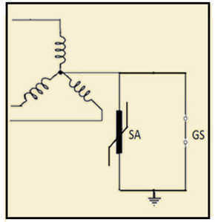
Why a GIC Neutral-blocking Surge Arrester
We Propose

Slide 25
Why a GIC Neutral-blocking Surge Arrester
It must therefore be concluded, based on state-design criteria, the inclusion of a capacitor bank in a neutral- blocking scheme can not be justified from an engineering standpoint

Slide 26
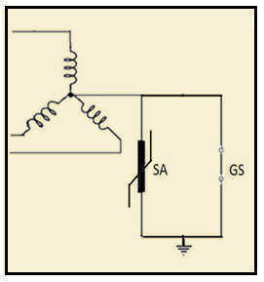
Why a Neutral-Blocking Surge
Arrester
Steady-state conditions with proposed arrester-device deployed
Unlikely state for Solar GMD
Very unlikely state for EMP/E3

Slide 27
Steady-state conditions: Arrester-device deployment Analysis
Impact on all AC steady-state variables
Impact on grounding ratio X₀/X₁
Impact on zero-sequence current flow
Surge-arrester specs

Slide 28
Steady-state conditions: Arrester-device deployment Analysis
.
Typical Transformer apparatus:
Three-winding grounded Wye-Wye-Delta Autotransformer
Two-winding Delta-Wye (grounded) GSU

Slide 29
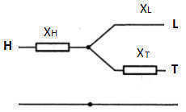
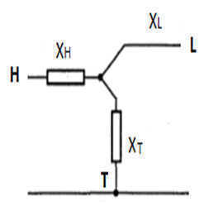
Normal Steady-State Conditions
Typical three-winding Autotransformer
Positive/negative sequence per-unit equivalent circuit
Zero-sequence per-unit equivalent circuit

Slide 30
Steady-State Performance
Three-winding Autotransformer/Numerical Example
Grounding Coefficient before and after arrester deployment
Nameplate 500/435/100 MVA 500/345/66 KV
Grounded YY∆ Connection
X_{HL} = 0.10 pu on a 500 KV/500 MVA base
X_{HT} = 0.17 pu on a 500 KV/100 MVA base
X_{LT} = 0.15 pu on a 66 KV/100 MVA base

Slide 31
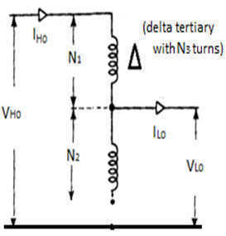
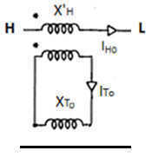
Normal Steady-State conditions: Neutral Device deployed
Three-winding Autotransformer
One-line diagram of device-caused neutral-to-ground isolation: zero-
sequence flow
Zero-sequence circuit with neutral isolated from ground

Slide 32
Steady-State Performance
Three-winding Autotransformer/Numerical Example
Grounding Coefficient before and after neutral arrester deployment
Conversion to 500 MVA base
X_{HL} = 0.10 pu
X_{HT} = 0.17 x 5 = 0.85 pu
X_{LT} = 0.15 x 5 = 0.75 pu

Slide 33
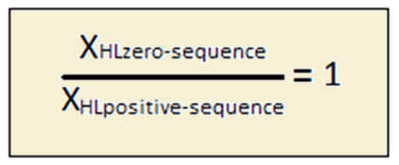
Steady-State Performance
Three-winding Autotransformer/Numerical Example
Grounding Coefficient for normal conditions
(no arrester blocking device deployment)

Slide 34
Steady-State Performance
Three-winding Autotransformer
Numerical Example
Grounding Coefficient before and after arrester deployment
Windings reactance computation
X_{H} = 0.5(X_{HL} + X_{HT} - X_{LT}) = 0.5(0.10 + 0.85 - 0.75) = 0.1 pu
X_{L} = 0.5(X_{HL} + X_{LT} - X_{HT}) = 0.5(0.10 + 0.75 - 0.85) = 0.0 pu
X_{T} = 0.5(X_{LT} + X_{HT} - X_{HL}) = 0.5(0.75 + 0.85 - 0.10) = 0.75 pu

Slide 35
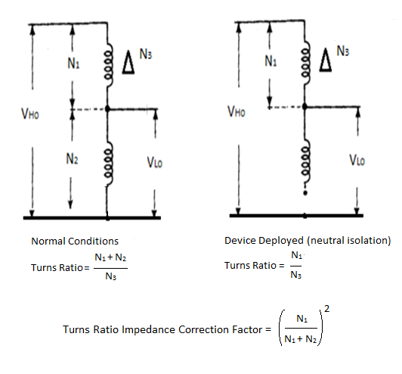
Steady-State Performance
High-to-Tertiary Turns-ratios / Correction factor before and after arrester deployment (causing zero-sequence neutral-to-ground isolation)

Slide 36
Steady-State Performance
Grounding Coefficient after device deployment
Turns-ratio correction factor
Prevailing zero-sequence High-to-Low reactance becoming:
X’_{HT} = X_{HT} = 0.85 x 0.1 = 0.085 pu

Slide 37
Steady-State Performance
Three-winding Autotransformer/Numerical Example
Grounding Coefficient after neutral arrester
Deployment

Slide 38
Steady-State Performance
Three-winding Autotransformer:
Grounding Coefficient Summary
No neutral arrester deployment = 1.0
Neutral arrester deployment = 0.85
Note: grounding coefficient of 1.0 corresponds to a solidly-grounded equipment (IEEE Standard)

Slide 39
Steady-State Performance
It can be then securely asserted, from the steady-state consideration, a capacitor-bank application could not be justified from an engineering standpoint for the protection of a grid autotransformer

Slide 40
Steady-state Performance GSU Transformer
No zero-sequence flow may come from the generation side
Zero-sequence unbalance flow may develop from the transmission line side due to load or from line-parameter dissymmetry

Slide 41
Steady-state Performance GSU Transformer
Zero-sequence components typically negligible
Neutral shift would be limited to a Ferranti-rise in the zero-sequence network
Zero-sequence flow through GSU immaterial as it refers to a line-end apparatus
Arrester device lends itself to a straight-forward specification from the unbalance examination

Slide 42
Conclusions
Steady-state performance, parametrical invariance, GIC blocking, ground-faults, zero-sequence current residuals, etc, the standalone surge-arrester device compares favorably with the one based on a capacitor bank, yet without any of its undeniable inherent risks
The difference can only be found at the blocking-function means: one performed by a capacitor bank and another by a common surge arrester

Slide 43
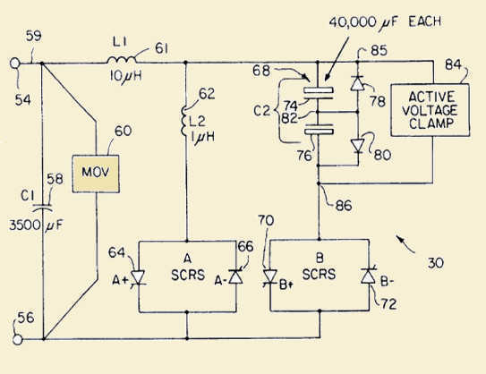
Conclusions
Capacitor Device Arrester Device

Slide 44
Final Thoughts
Legitimate reservations regarding the incremental cost/benefit of adding massive capacitor-bank assemblies, with convoluted ancillaries, merely to secure the flow of inconsequential, quasi-parasitic, ground currents associated to a few transformers at limited and short steady-state situations
Legitimate questions regarding such an incremental cost/benefit evaluation minding neutral-blocking units might operate infrequently and able to reduce basically around fifty percent of GIC upon some autotransformers *
* GIC suppression achievable only by placing one device at each apparatus

Slide 45
Final Thoughts
Comprehensive utility-industry R&D has established consensus regarding GIC-blocking strategies
Studies on major power grids conclusively indicate that a discrete placing of blockers at selected apparatus will produce only a marginal protective benefit. This becomes critical under EMP conditions
Only way to eliminate GIC from the electricity grid is by the installation of one device at each transformer

Slide 46
Future/Ongoing Work
R&D on actionable early sensing of EMP shock waves (presently in advanced testing state)
R&D to favorably address the challenging issue of GIC current interruption

Slide 47
Questions ?
Feel free to contact us and/or also to request a personal presentation of this material for an in-depth discussion
www.resilientgrids.com

