Slide 1
A Risk-levelized approach for an EMP-mitigation Strategy
Alberto Ramirez Orquin Vanessa Ramirez
Resilient Grids, LLC
Audio Presentation

Slide 2
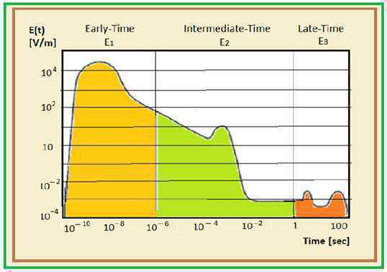
Nature of Electronic Magnetic Pulse (EMP)

Slide 3
Nature of EMP
EMP/E1 and E2 shock waves, leading to ultra-fast overvoltage surges
Cannot couple with EHV Transmission lines
E3 pulse can couple with EHV Transmission lines
Similar phenomenon to Solar Storms

Slide 4
Nuclear EMP History
Soviet HEMP tests in the early 1960’s were reported to have damaged power equipment
Russian military writings claim to have a super EMP weapon that can generate 200 kV/m*
*Congressional Research Service, Clay Wilson, High Altitude Electromagnetic Pulse (HEMP) and High Power Microwave (HPM) Devices: Threat Assessments,” 2008

Slide 5
Current Nuclear EMP
Various countries have optimized nuclear weapons for HEMP impact
According to a recent published Pentagon assessment, NK is now capable of launching an EMP attack over the continental USA

Slide 6
EMP History
No specific EMP full-scale testing has ever been carried out in the Free World
Possible broad utility system blackouts
Long-lasting grid devastation prediction
from E1 debatable

Slide 7
EMP Mitigation Strategies
Prevention
vs.
Recovery

Slide 8
EMP Mitigation Attributes
Fundamentals
vs.
Electronic Sophistication

Slide 9
EMP Mitigation Attributes
Fundamentals
Power System Basic Components
Generators, Transformers, Breakers, T&D
Auxiliary Services, Pumps, Fans, DC, Fuels, Prime Movers, etc.
Electronic Sophistication
Computer and Information Systems, Automation, Artificial Intelligence, Robotics
SCADA, EMS, DMS, PLC

Slide 10
The E1 Early-pulse Mitigation
Thousands of installations
Millions of components of very diverse nature, technology and vintage
A full preventative attempt to harden each item would consequently result in an overwhelming task

Slide 11
The E1 Early-Pulse Impact
Not direct impact to major power equipment
Insulation breakdown in electric/electronic circuitry
Large number of computer, microprocessors
Control centers SCADA/EMS/DMS/PLC
Distribution Lines and Transformers

Slide 12
The Early-Pulse Mitigation
Inherent built-in hardening taking place as compliant new or refurbished hardware constantly merges into the existing utility
E1 or E2 shocks do not couple with EHV transmission lines and hence cannot damage major power equipment

Slide 13
The Institutional Stance
Relates to solar GMD and based on situational awareness in combination with a set of comprehensive operational procedures. The process utilizes an extensive network-wide simulation, equipment monitoring and supervision of transformer response, based on elaborated thermal models.
Strategy basically entails a power management, in anticipation of a sun-originated Coronal Mass Ejection CME arrival; this procedure taking place after warnings issued primarily by NASA and NOAA. Moreover, a parametrical identification of the meteor gets carried out, including GIC magnitude and attendant circuital-trace distribution. With this data, the potential voltage response and transformers thermal impact is ascertained
Overall evaluation of both active-power derating and reactive-power rationing/optimization of the system is carried out; this process may finally reflect as constraints over power plant outputs and load flows in order to primarily preserve both synchronous and voltage stability.

Slide 14
The Institutional Stance
DOE Electromagnetic Pulse Resilience Action Plan
The Joint Strategy identified five strategic goals:
Improve and Share Understanding of EMP: Threat,
Effects, and Impacts
2. Identify Priority Infrastructure
3. Test and Promote Mitigation and Protection
Approaches
Enhance Response and Recovery Capabilities to an
EMP Attack
Share Best Practices Across Government and
Industry, Nationally and Internationally

Slide 15
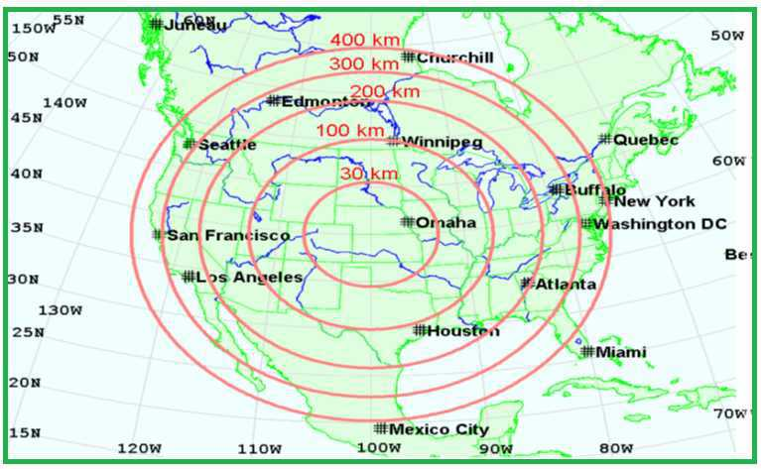
HEMP Burst Height Sensitivity
E1 HEMP exposed regions for several heights. Red circles show the exposed regions for the given burst heights, for a nuclear burst over the central U.S. [Oak Ridge National Lab]
15

Slide 16
The Institutional Recognition
‘EMP and Geomagnetic-Storm events have the potential to physically damage electrical and electronic equipment throughout North America’s critical infrastructure, notably including Extra-High Voltage transformers and industrial control systems like Supervisory Control and Data Acquisition (SCADA) systems’*
*NERC Executive Brief ‘Electromagnetic Pulse & Geomagnetic Storm Events’

Slide 17
Findings from a 2016 Research
Research funded by PSERC, DOE, NSF, EPRI, BPA, the State of Illinois DCEO, and ARPA-E*, concludes that: “The two key concerns from a big storm or an HEMP are:
Large scale blackout due to voltage collapse, and
2) Permanent transformer damage due to
overheating”.
*ARPA-E, stands for Advanced Research Projects Agency-Energy

Slide 18
A Risk-levelized basis for an
EMP-mitigation Strategy
All things considered, it seems a strategy to deal holistically with EMP critical-infrastructure security could
be primarily based on:
A basically restorative approach for E1/E2 with emphasis on its Electronic-sophistication assets, complemented with key Control Facility hardening
A basically preventative approach for E3 with significant emphasis on Fundamental assets, by means of hardening all grid transformers

Slide 19
Need for GIC Mitigation
GIC currents, quasi-DC nature (up to 2 KA)
Saturate/overload the magnetic circuits of major power transformer and shunt reactors
Ample spectrum of harmonics
Mechanical/thermal problems, including vibration and hot spots
Transformer health index and expected loss of useful life
Permanent outage cannot be ruled out

Slide 20
Need for a Cost-Effective GIC Mitigation
Comprehensive utility-industry R&D has established a consensus regarding GIC-blocking strategies
Major studies on power grids conclusively indicate that a discrete placing of blockers at selected apparatus will produce only a marginal protective benefit. This becomes critical under EMP conditions
Only way to eliminate GIC from the electricity grid is by the installation of one device at each transformer

Slide 21
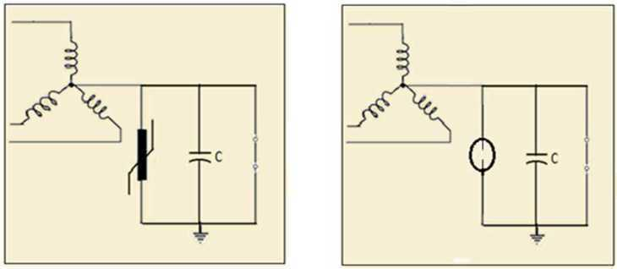
Capacitor GIC-Blocking Schemes
Capacitor Neutral-Blocking Device
Alternative Capacitor Device

Slide 22
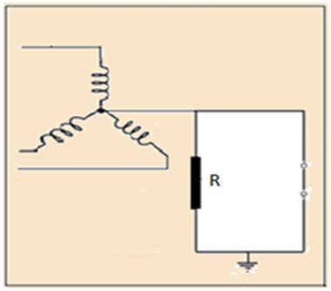
Resistor GIC-Reducing
Concept
Resistor Mitigation Device

Slide 23
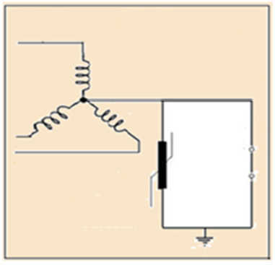
Surge Arrester GIC-Blocking
Concept
Surge-Arrester Device

Slide 24
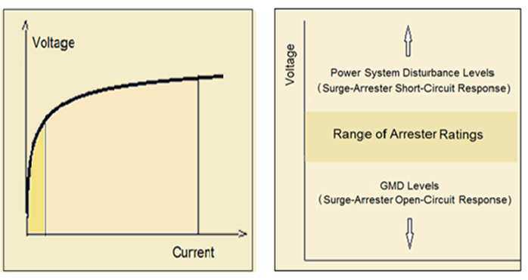
Arrester GIC-Blocking Concept
Typical Volt-Ampere characteristic of metal-oxide surge arresters
Comparative of transformer neutral voltage ranges

Slide 25
Arrester GIC-Blocking Concept
Typical Volt-Ampere characteristic of metal-oxide surge arresters
Comparative of transformer neutral-voltage ranges

Slide 26
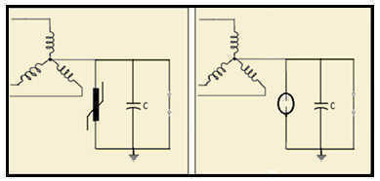
Arrester GIC-Blocking Concept
Capacitor-bank footprint/rating, a limiting factor
Capacitor-bank constrained to Distribution lower-voltage ratings
Protective devices consequently constrained to Distribution lower-voltage ratings

Slide 27
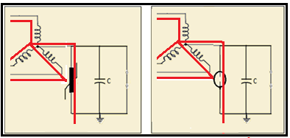
Critical Considerations
As protective devices are constrained to Distribution lower-voltage ratings, a sizable EMP impact will set a neutral voltage causing either a surge arrester bypass to ground or alternatively conduction of the spark gap
GIC will then flow through the transformer to ground rendering the device useless

Slide 28
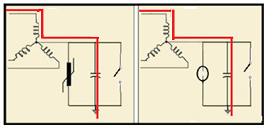
A Capacitor Neutral-Blocking Device Dilemma
Higher blocking-device ratings and attendant protecting devices (say up to 20 KV) could be attempted, despite its exponential cost/size impact, to prevent EMP shocks from circumventing the unit * However, ground faults causing lower than said 20-KV neutral voltages would directly impact both device capacitor and resonance-damping resistors setting extreme power-rating requirements for a critical time until protective switching happens * This has already happened for one design which was originally, and for many years 2.4 KV, yet currently at 8 KV; potentially compelled to go higher.

Slide 29
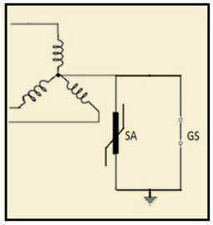
Critical Considerations
The only constraint upon a single surge-arrester device stems from its dual-functionality requirements
Much higher ratings possible making EMP neutral voltage inductions inconsequential to blocking GIC

Slide 30
Probing Further, Technical Issues
Sensing and Deployment
GIC detection and switching of mitigation devices an ongoing endeavor
Severe EMP, a DC current-interruption challenge
E1 pulse not a menace to major power apparatus
E1 pulse not a challenge from sensing standpoint

Slide 31
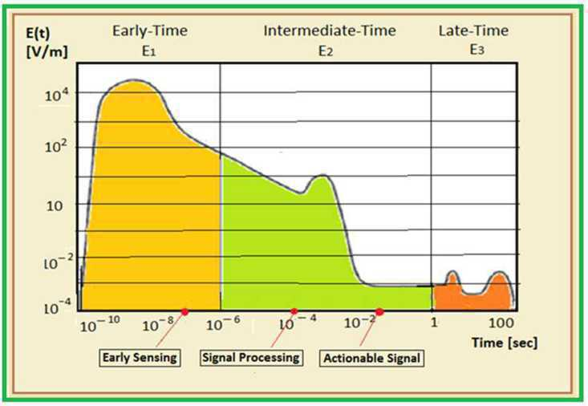
Proposed Sensor with Actionable Signal

Slide 32
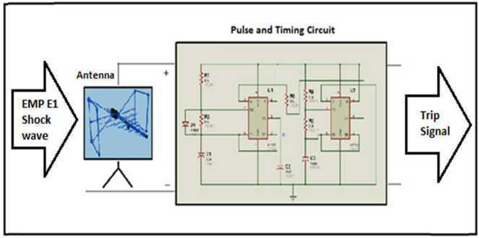
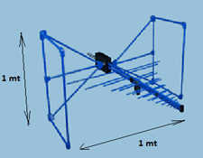
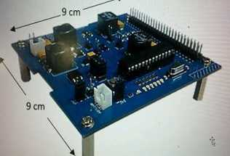
Proposed Sensor with Actionable Signal

Slide 33
Questions?
Thank You
www.resilientgrids.com

