Slide 1
A Surge-Arrester
for
GIC Suppression
Alberto Ramirez Orquin
Vanessa Ramirez
Resilient Grids, LLC

Slide 2
Why Surge Arresters?...

Slide 3
Surge Arrester of the Present
The most common, tested and standardized component ever designed for power system protection
It presents a definite potential to become a cost-effective asset to mitigate GMD/EMP GIC deleterious effects

Slide 4
Surge Arrester of the Future
“I can confidently predict that in the very near future, we will see much smarter arresters at very little added cost. Arresters will come from the factory with internal brains that will perform many useful tasks not even considered today.”
Jonathan Woodworth, Arresterworks
INMR 2015 World Congress Munich Germany

Slide 5
EMP State of the Art
Substantial Gaps in EMP Knowledge

Slide 6
Assumptions in Solar-GMD Mitigation
Manageable by means of Operating Procedures
Equipment Resilience
GIC-magnitude control not considered as a mitigation strategy

Slide 7
Key Differences Between Solar GMD and EMP E3
Ample time for Solar-Storm alerts
EMP E3, basically no alerts for a minimal preparation; window of minutes to set any operational procedures
EMP E3 preceded by EMP E1/E2 which could have already compromised Command and Control/Protection Systems
EMP has severe Electric Fields which could also put Circuit Breakers at risk

Slide 8
Transformer Resilience
Based on tests run by a major manufacturer in High-power Lab with DC currents up to 200 A (no AC load current)
Core losses depending on maximum flux density and frequency (unchanged after full saturation)

Slide 9
Transformer Resilience
200 A represents a 40 percent overload in a transformer winding with a current rating of 500 A
200 A would cause the rated copper loss in that transformer winding to near double
Transformer winding would experience a near fifty percent total power losses with attendant fifty percent equipment overheating potentially lasting several minutes

Slide 10
GIC from EMP-E3 could reach levels that compare favorably with apparatus rated currents
AC Breakers facing DC (non-zero crossing) current interruption
Prolonged GIC exposure of Transformers and Circuit Breakers
Potential Challenges Revealed

Slide 11
AC Circuit-Breaker poles potentially exposed to a welding effect from a strong DC-arc (regardless of interruption outcome)
Apparatus Exposure Under EMP

Slide 12
Grid Security
GIC-magnitude limitation a matter of endeavor in GMD/EMP E3 power-grid reliability engineering
Several attempts to suppress GIC have been studied for decades

Slide 13
The Critical Importance of GIC Suppression
GIC-magnitude, potential damage to major power equipment with a limited world supply; no USA Manufacturer
A Recovery Strategy could face formidable logistic challenges

Slide 14
Selected References for Grid GIC Control
Zhenhua Wang, Aster Amahatsion, Jovil Rajesh Benny Stephen, Larry Anderson, American Electric Power, “GIC Flow Characteristics and Mitigation”. CIGRE USNC GOTF 2017 Symposioum Paper Session 090217.
K. S. Shetye, T. J. Overbye, Q. Qiu and J. Fleeman, "Geomagnetic disturbance modeling results for the AEP system: A case study", Proc. IEEE Power Energy Soc. Gen. Meeting, pp. 1-5, Jul. 2013.
H. Etemadi and A. Rezaei-Zare, "Optimal Placement of GIC Blocking Devices for Geomagnetic Disturbance Mitigation," in IEEE Transactions on Power Systems, vol. 29, no. 6, pp. 2753-2762, Nov. 2014, doi: 10.1109/TPWRS.2014.2309004.
H. Zhu and T. Overbye, "Blocking device placement for mitigating the effects of geomagnetically induced currents", Proc. IEEE Power Energy Soc. Gen. Meeting Boston MA, pp. 1, 2016.
Y. Liang, H. Zhu and D. Chen, "Optimal blocker placement for mitigating the effects of geomagnetic induced currents using branch and cut algorithm", Proc. North Amer. Power Symp., pp. 1-6, Oct. 2015

Slide 15
Selected References for Grid GIC Control
T. J. Overbye, K. S. Shetye, T. R. Hutchins, Q. Qiu and J. D. Weber, "Power grid sensitivity analysis of geomagnetically induced currents", IEEE Trans. Power Syst., vol. 28, no. 4, pp. 4821-4828, Nov. 2013.
Z. M. K. Abda, N. F. A. Aziz, M. Z. A. A. Kadir and Z. A. Rhazali, "A Review of Geomagnetically Induced Current Effects on Electrical Power System: Principles and Theory," in IEEE Access, vol. 8, pp. 200237-200258, 2020, doi: 10.1109/ACCESS.2020.3034347.
Hong-zhan Nie et al.”Optimal Governance of GIC in Power Grid Based on the Sensitivity Analysis Method” March 2012DOI: Power and Energy Engineering Conference (APPEEC), 2012 Asia-Pacific
A. Rezaei-Zare and A. H. Etemadi, "Optimal placement of GIC blocking devices considering equipment thermal limits and power system operation constraints", IEEE Trans. Power Del., vol. 33, no. 1, pp. 200-208, Feb. 2018.
.D. H. Boteler and R. J. Pirjola, "Modelling geomagnetically induced currents produced by realistic and uniform electric fields", IEEE Trans. Power Del., vol. 13, no. 4, pp. 1303-1308, Oct. 1998.

Slide 16
“The effectiveness of a neutral-blocking device is very limited if the deployment is in a small scale”
Conclusion
from recent
AEP Papers

Slide 17
American Electric Power conclusion is particularly significant
AEP Transmission, the largest EHV/UHV system in the nation (40,000 mi, 11 States )*
* More extensive EHV than all other U.S. utilities combined
Significance
of AEP
findings

Slide 18
Need for a Cost-Effective GIC Mitigation
World experts had concluded also that only a massive grid device deployment would be required to suppress GIC and its harmful effects.
A partial or incomplete implementation would render that mitigation effort ineffective setting winners and losers in a sort of grid GIC Rollercoaster

Slide 19
Electric Utility Systems and Practices
Any largescale grid application calls for equipment having a solid, long-standing industrial record
Units intended for such a largescale deployment must consequently pass and comply with well-established industry tests and standards

Slide 20
Electric Utility Systems and Practices
Equipment intended for a massive grid deployment must have well-known failure modes/rates for a full evaluation of the composite power-system reliability impact of their installation
Any extensive use of experimental prototypes for GIC control could be dicey and prone to be in disregard of basic Electric Utility Systems and Practices

Slide 21
Electric Utility Systems and Practices
Existing standards and tests can be applied to this new GIC-mitigation surge-arrester function in a straightforward way
There is a successful operating experience of at least one major US Utility with surge-arrester neutral grounding of 230 KV and 115 KV transformers

Slide 22
Advanced Technology for SA in the Distribution Class
SA have achieved a high energy absorption, stable opera­tion and durability
General failure rates for HV/EHV/UHV SA can be considered infinitesimal for all practical purposes

Slide 23
Advanced Technology for SA in the Distribution Class
State of the art has reached a level where this GIC-blocking device can be connected on a permanent basis
This feature avoids depending on sensing/monitoring and complex AC/DC switching; all possibly under EMP-weakened or hacked systems

Slide 24
Resilient Grids’ R&D
In-depth R&D carried out to vet and come out with this novel protective functionality of Surge Arresters

Slide 25
Scope of Resilient Grids’ R&D
Resistor Blocking Performance
Resistor Energy/Power
Resistor General Specs
Surge Arrester Specs
Surge Arrester Blocking Duty
Surge Arrester Energy/Power
Voltage Class
Arcing Grounds
Grounding Coefficients
Notes:
We have carried out for many years an extensive and well-documented R&D on this matter, Have to acknowledge the significant feedback from the industry. This slide shows key specific items of interest in order to validate our concept

Slide 26
Scope of Resilient Grids’ R&D
SLGF Levels
Reclosing Issues
SLGF Neutral Shifts
Relay Applications (including Close-in faults)
Device in the Steady State
Circuit-parameter Impact
Transformer Equivalent Circuits
Ground-current residuals
Substation Design Impact
Ground-Switch Operation

Slide 27
Selected References from ResilientGrids LLC
Modeling Analysis and Design of Surge-Arrester Devices for Transformer GIC Blocking, April 2019
An EMP Mitigation Perspective: System and Components; CIGRE US National Committee 2017, Grid of the Future Symposium; Cleveland, OH, October 2017
Blocking Geomagnetically Induced Currents (GIC) with Surge Arresters; CIGRE US National Committee 2016 Grid of the Future Symposium; Philadelphia, PA, October 2016
Mitigating Geomagnetic Induced Currents Using Surge Arresters; INMR World Conference, Munich, Germany, October 2015
Addressing Ground-Induced-Current (GIC) Transformer Protection, Paper A2-110, CIGRE Biannual Central Session, Paris, Aug. 2014
Ultra-High-Speed Relaying: A Setting Methodology, IEEE Transactions on Power Delivery, Vol. PWRD pp. 52-59; IEEE/PES
Modeling Series Capacitor Reinsertion in AC Studies, IEEE Transactions on Power Delivery, Vol. PWRD 4, pp. 1217-1222; IEEE/PES
Series Capacitor Planning Environment, Paper 86 TDCE SC, T&D Conference and Exposition, Anaheim CA

Slide 28
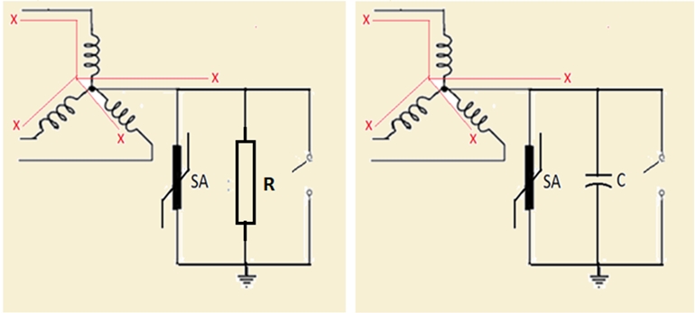
Neutral Blocking Device Concepts
Notes:
Slide shows two neutral-blocking device concepts, one based on a linear resistor and the other one on a capacitor, in both cases there is a SA device to protect those blocking components. We may want to pay attention to the fact that the protective SA in parallel is also performing a not duly appreciated blocking functions identical to the ones of the main components, otherwise the GIC current could flow through the surge arresters to ground rendering the device useless. This ability of the surge arrester has been fully tested.

Slide 29
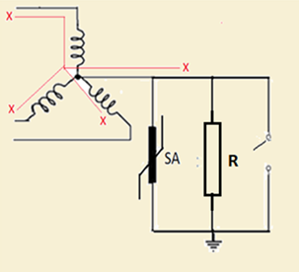
Resistive Means for GIC Control

Slide 30
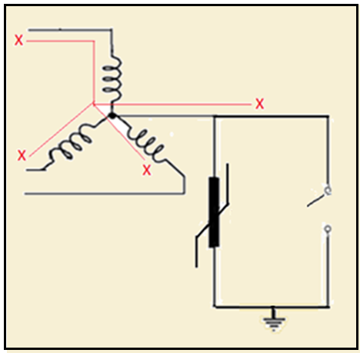
Surge Arrester Concept

Slide 31
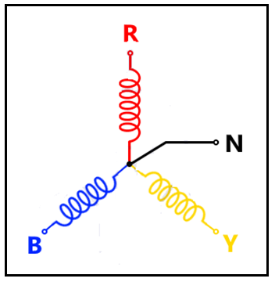
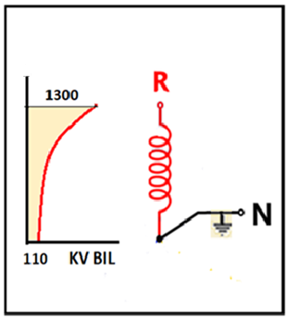
Graded Insulation of Solidly-grounded-neutral Equipment

Slide 32
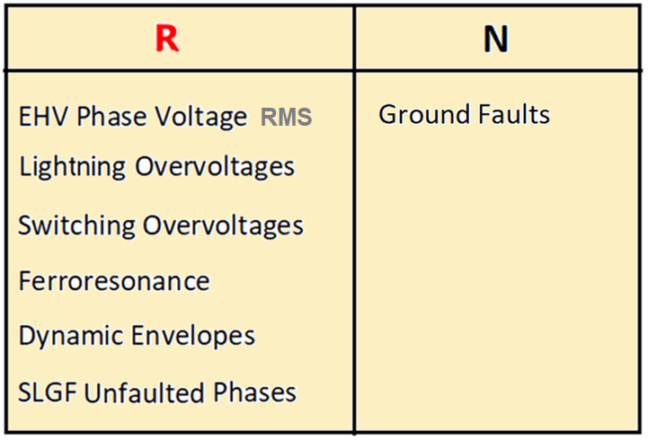
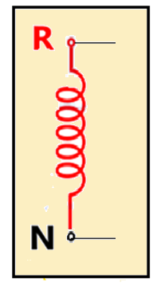
Winding-end Exposure

Slide 33
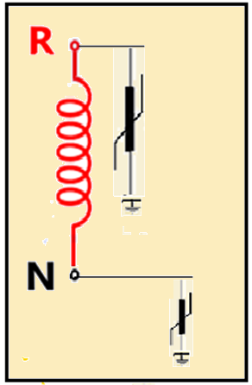
A well-established Industry System and Practices for Insulation Coordination applies at both ends

Slide 34
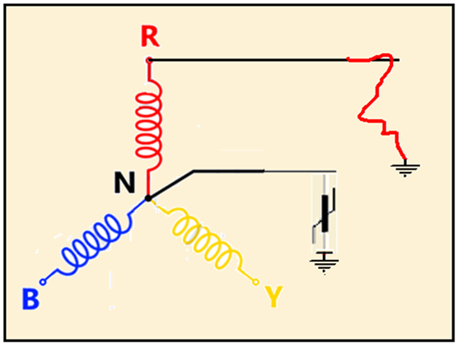
Arcing-ground
Inception/Evolution

Slide 35
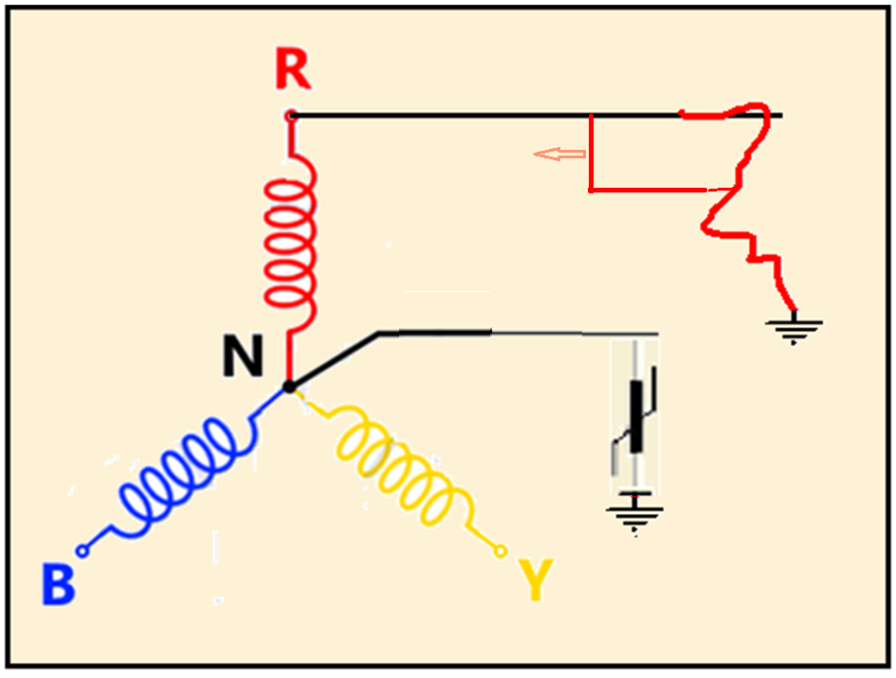
Arcing-ground Inception/Evolution (surge)

Slide 36
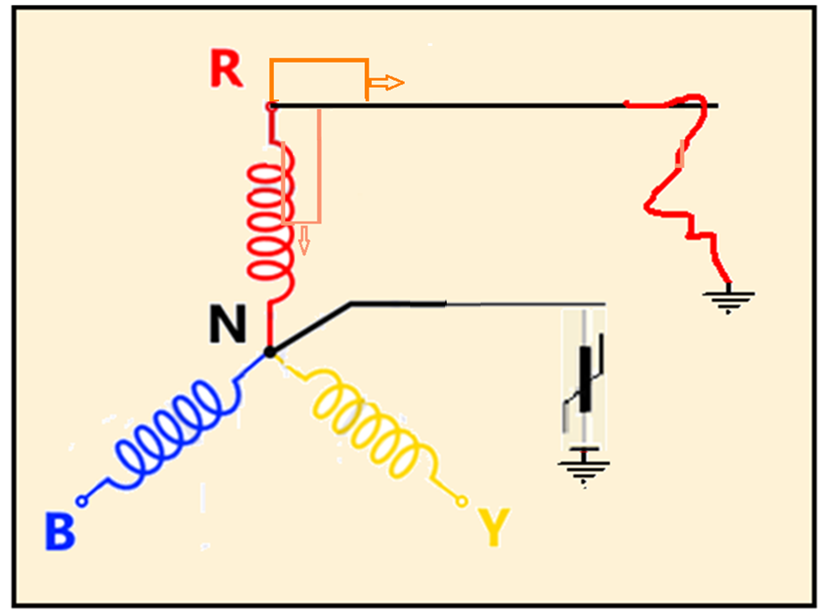
Arcing-ground
Evolution (surge)

Slide 37
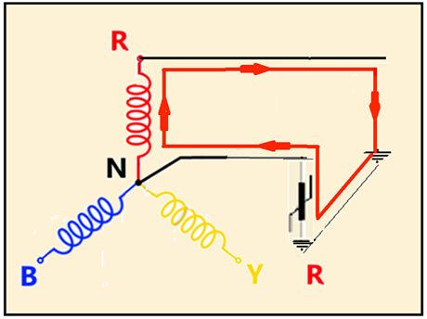
SLGF Inception through SA

Slide 38
Regular SLGF with SA in Valve-Relief Mode
Notes:
Should the SA go into a valve relief state (not necessarily the case for today’s greater energy capability of SA of the class) a full SLGF is established. Mind that this current is only slightly higher than the one of the previous slide; a key fact regarding how the fault is seen by the line relays

Slide 39
Single Line-to-Ground Faults
Input data for the Arrester device design criteria
Not a limiting factor for the application of Surge Arresters to suppress GIC
Reclosing considerations can be dealt with simple relaying extensions of the already existing schemes
Notes:
Bla bla

Slide 40
Conclusions
Novel GIC-suppression ability of surge arresters has been explored in depth
Innovation consistent with Electric Utility System and Practices
Innovation compliant with Industry Testing and Standards
There is at least one major utility with an extensive/successful record for SA neutral-grounding of transformers at the 115 KV and 230 KV levels

Slide 41
Conclusions
Cost-effectiveness simplicity and compactness of this concept uniquely:
Enables a largescale application
Avoids any extensive substation redesign engineering
Allows for an early hardening of the power grid
Allows for underground applications

Slide 42
Conclusions
SA inherent sturdiness and reliability become critical attributes under an EMP shock, avoiding dependance on vulnerable Command, Control and Protection Systems
As a self standing hardware-based solution it greatly reduces hacking vulnerability
No rationale can be found to warrant additional components
Surge-arrester neutral grounding for GIC suppression proved to pose no discernible collateral risk to the integrity of the power transformer

Slide 43
Final Conclusion
A novel concept is submitted for consideration as a definite option to achieve a prompt hardening of our most critical infrastructure in a cost-effective manner

Slide 44
Resilient Grids LLC
For more information and in-depth technical developments visit our site:
Resilientgrids.com

